Slide 1
NA2 – The Physical and Data Link Layers
COMP 256 – Dickinson College
Prof. Braught
Spring 2023
Image from: https://dealna.com/Article/
Post/6564/Networking-Accessories

Slide 2
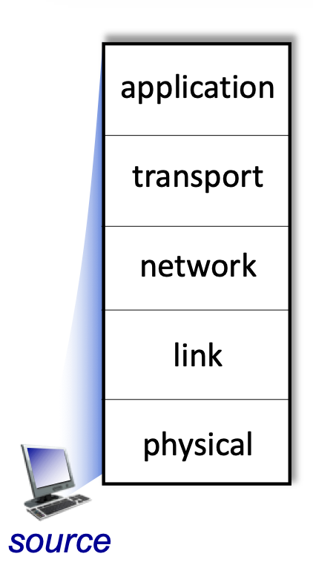
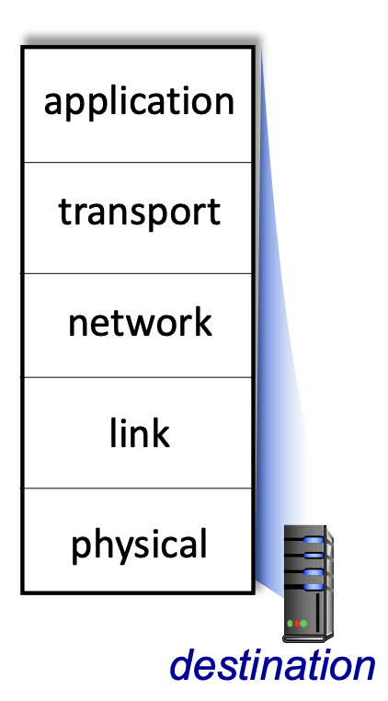
Bridging the Chasm: Network Layers
Getting information from one application to another.
Application Layer Service
HTTP
HTTP
TCP/
UDP
Transport Layer Services
TCP/
UDP
Source
Network Layer Services
Destination
IP
IP
Ether- net
Link Layer Services
Ether- net
Physical Layer Services
Wires
Wires
Image adapted from: http://gaia.cs.umass.edu/kurose_ross/videos/1/5/1.5_video_slides_posted.pptx

Slide 3
Network Data Encapsulation
Data
Data
Data
Data
Link Layer Info
Network Layer Info
Message
Transport Layer Info
Application
Layer Info

Slide 4
The Physical Layer

Slide 5
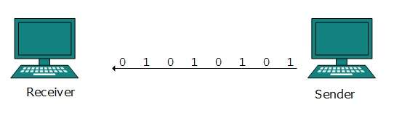
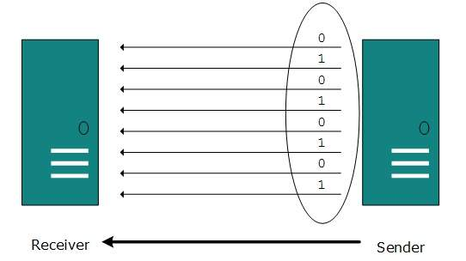
Physical Layer: Data Transmission
Physically transmits bits across a communication link.
Serial Transmission: Bits are sent and received one at a time, one after the other.
Parallel Transmission: Multiple bits are sent simultaneously on separate wires, fibers or channels.
Images from: https://www.tutorialspoint.com/data_communication_computer_network/digital_transmission.htm
Notes:
Most things we think about as networking use serial transmission.

Slide 6
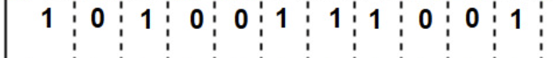
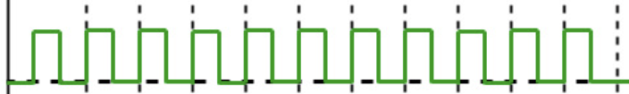
Physical Layer: Transmitting Bits
Clock
Cycle
Data
Source
Destination
Clock
Newest
Oldest
Rising Edge
Time
The source node transmits the Data bits at the rate of one per clock cycle
The destination node samples the signal at the rate determined by a clock (red arrows).
Samples typically occur on the rising edge of the clock.
Image adapted from: https://www.geeksforgeeks.org/manchester-encoding-in-computer-network/
Notes:
Whether we are transmitting serially or in parallel, each wire or communication channel transmits one bit.
Here we see a diagram of a source node transmitting bits to a destination node.
- The source’s network card contains an electronic clock (similar to the CPU clock)
- The speed at which this clock runs determines the rate at which the bits are sent.
- One bit is sent per clock cycle (like a tick of the clock).
- A cycle consist of the clock having a high low value for a period of time and then transitioning to a high value.
- Note time is running from right to left here.
- the 1 bit on the right was the one that was sent the longest ago.
Moving right to left:
- The source places the first data value (1) to be transmitted on the communication link
- It holds that value there for one clock cycle.
- during that time the destination will read the data from the link.
- Then at the start of the next clock cycle the source places the next value onto the link.
- And holds it there for one clock cycle.
- Again the destination reads that value from the link during the clock cycle.
- And so on, until all data has been transmitted.
Note that the destination must also have a clock to decide when to read the data from the link.
- Ideally, the destination will read the data right in the middle of the clock cycle.
- We call this reading - sampling – the data.
- So ”The destination samples the data in the middle of a clock cycle”
Sampling in the middle of a clock cycle helps to deal with some electrical engineering challenges that arise from transmitting signals across links.
- That is beyond the scope of this course.
- You may hear some about it in Computer Networks (COMP 352) but it is often an Signals and Systems course in electrical engineering.

Slide 7

Clock Synchronization
What could happen if the clocks are not synchronized?
The clocks on the sender and receiver must be synchronized – i.e. running at the same rate.
Image adapted from: https://www.geeksforgeeks.org/manchester-encoding-in-computer-network/
Notes:
Synchronized:
- Same rate – the ”rising and falling edges” of the clock on sender and receiver happen at the same time.
Here the clock at the destination (red arrows) is running just a little slower than the clock at the source.
- What happens?
It may seem like this is just a simple engineering problem…
but its actually pretty hard (impossible) to get clocks to run at exactly the same rate.
It’s easy to think about synchronizing clocks on human time scales
- Where a second or so difference doesn’t matter.
But at the speeds at which network communications operate it is actually a hard problem:
- For a bandwidth of 100Mbps we need to send 100,000,000 bits per second.
- So the clock cycle would be 1/100,000,000 seconds (1x10^-9 seconds = 1 ns) long.
- So here if the difference between the source and destination clocks is 0.1 ns
- then ~ every 10th bit would be read incorrectly.
- that would be unacceptable… so the synchronization has be be better than 0.1 ns.
To put some scale on that:
- imagine synchronizing your watch with a friend to within 0.1ns or 10^-10 seconds.
- it would take 10^10 seconds (~ 316 years) for your watches to be one second apart!
So the point is that the clocks need to highly synchronized and that is a hard problem.
- So instead, to make it easier, the clocks get resynchronized ofthen.
- We’ll see one way that this is handled in just a little when we discuss Ethernet in the data link layer.

Slide 8
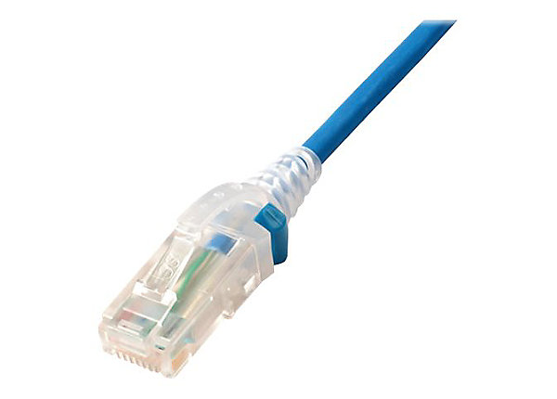
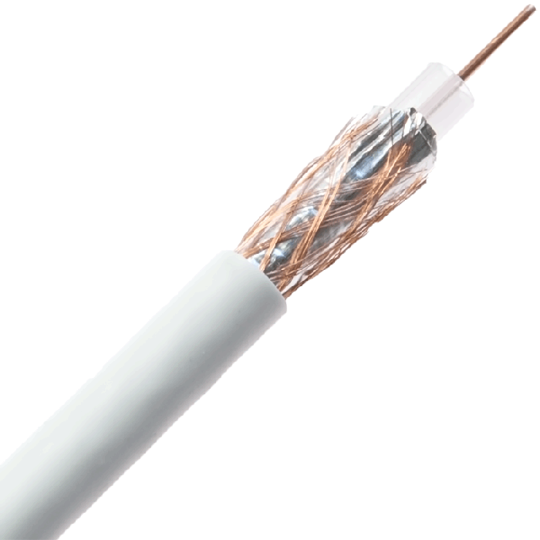
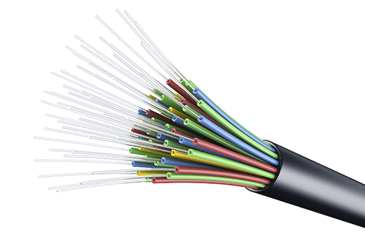
Physical Layer: Bandwidth
The bandwidth of a communication link is the maximum number of bits that can be reliably transferred per unit of time.
Determined by the clock speed which is limited by the physical medium and the connectors.
Twisted
Pair
Coaxial
Cable
Fiber Optic
Cable
WiFi
Cellular
100’s Mbps
per
channel
100 Mbps –
10 Gbps
10 Gbps –
100’s Gbps
100 Mbps –
1 Gbps
50 Mbps -
1 Gbps (5G)
Image adapted from: http://gaia.cs.umass.edu/kurose_ross/videos/1/2/1.2_video_slides_posted.pptx
Notes:
The design of physical medium and connectors are engineering disciplines all their own.
The Harrisburg area happens to have a lot of Connector design companies.
- In fact it is likely that many of the network connectors that you have used were designed very close to here.
- Many of my friends have made careers of designing connectors
- My wife included.

Slide 9
Data Rate vs Bandwidth
The data rate (or throughput) of a network is the number of bits of data that are actually transferred per unit of time.
The data rate is a property of the hosts, the network layers, the network interfaces and the bandwidth of the communication links.
Notes:
Notes:
- The physical layer is part of this, but it is not the entirety of it.
- Data rate does not include transmission of the overhead of packet header information that is added at each layer.
Also note:
- In marketing and general conversational used bandwidth and data rate (i.e. throughput) are used interchangeably.
- But technically they refer to different things.

Slide 10
Physical Layer Encodings
To transfer bits a network interface card (NIC) must encode the bits on a communication link.
For example, as electrical signals on wire(s), as light pulses through a fiber optic cable, or on radio waves in the air.

Slide 11
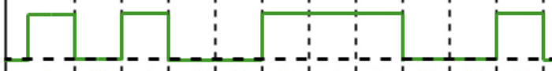
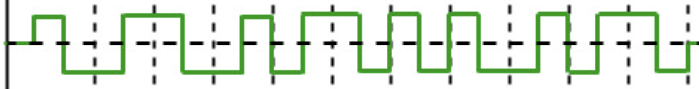
Some Physical Layer Encodings for Wires
Data
Non-Return
To Zero (NRZ)
Source
Manchester
Destination
Clock
Newest
Oldest
Time
Image adapted from: https://book.systemsapproach.org/direct/encoding.html
Notes:
There are different ways to encode the 1’s and 0’s into electrical signals on the wires.
NRZ: Non-Return To Zero
- 0’s are encoded as a low voltage near ground
- 1’s are encoded as a sufficiently positive voltage that is differentiable from ground.
Manchester Encoding:
- 1’s are encoded as a transition from ground to a positive voltage at the rising edge of the clock.
- Remember we read from right to left.
- For example, the right most 1 is the rising edge of the cock corresponds to the rising edge of the data.
- 0’s are encoded as a transition from a positive voltage to ground at the rising edge of the clock
Note: Ethernet uses Inverted Manchester Encoding.
- Just switch which transition represents 0’s and 1’s.

Slide 12
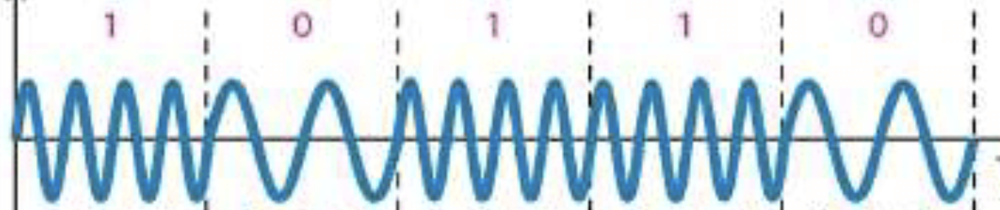
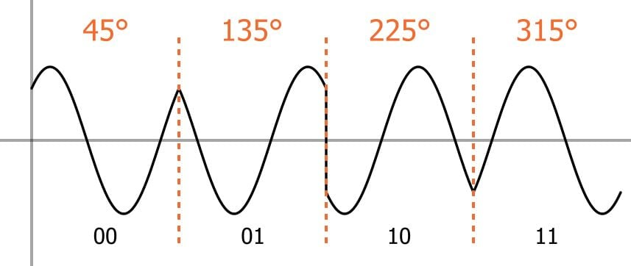
Some Physical Layer Encodings for WiFi/Radio
Frequency
Shift Keying
Encoding
Destination
Source
Newest
Oldest
Time
Image adapted from: https://www.researchgate.net/figure/Frequency-Shift-Keying-FSK-signal-5_fig6_309595949
Quadrature
Phase Shift
Keying
Image from: https://www.allaboutcircuits.com/technical-articles/quadrature-phase-shift-keying-qpsk-modulation/
Notes:
Notice that Quadrature Phase Shift Keying is able to transmit multiple bits at a time (lightly parallel).
- But if the time intervals are equal this would double the bandwidth of the medium

Slide 13
The Data Link Layer

Slide 14
The (Data) Link Layer
Network interface cards add/understand extra information to pass messages between two or more neighboring nodes.
Ethernet
Notes:
There are many Data Link Layer technologies
- We will look at Ethernet
- It is by far the most widely use and has some interesting ideas.

Slide 15
Ethernet uses a Broadcast Medium
Ethernet frames (packets/messages) are broadcast* to all nodes on the local area network.
Each network interface card (NIC) has a unique 8-byte physical (MAC) address.
A node will only processes frames that are addressed to it.
Image adapted from: http://gaia.cs.umass.edu/kurose_ross/videos/6/4/6.4_video_slides.pptx
Notes:
MAC: Media Access Control
- Basically this is the Ethernet Interface Card in your computer.
Because frames are broadcast
- Every network interface card will receive every frame.
- However, nodes do not process every frame their card receives.
- They simply ignore frames that are not addressed to them.
- Frames that are addressed to them are then handed up to the next higher layer of abstraction.
* Technical Detail: Ethernet was designed to work over a broadcast medium.
- However, many more modern ethernet LANs typically use switching instead of broadcast.

Slide 16
Ethernet Frame Format
type
preamble
dest.
address
source
address
data (payload)
CRC
(8 bytes)
(6 bytes)
(6 bytes)
(2)
(64 – 1500 bytes)
(4 bytes)
preamble: 7 bytes of 1010 1010 and one byte of 1010 1011
source address: MAC address of node sending the frame.
dest. address: MAC address of node to receive the frame.
type: Information about size* of the payload.
payload: The bits of data being sent.
CRC: Cyclic Redundancy Code for detecting errors in transmission.
Image adapted from: http://gaia.cs.umass.edu/kurose_ross/videos/6/4/6.4_video_slides.pptx
Notes:
When an Ethernet data link layer is handed a packet of information to transmit it wraps it in a frame.
- The frame is where the Ethernet layer adds its additional information.
- Slightly different representation than our earlier diagram (in the upper right)
- This format is intended to represent a string of bytes and is commonly used in networking specifications and documentation.
Preamble: Why might that specific set of bytes be transmitted during the preamble?
Type: If this value is 64-1500 it indicates the number of bytes in the payload.
- Values other than 64-1500 have been assigned specialized meanings that allow different types of optimization.
- We won’t be discussing those.
Payload: This is the data handed off to the Data Link Layer by the Network layer.
- We know that the actual data we want to send is wrapped inside of other layers added by the network, transport and application layers, but it is buried in there

Slide 17
Ethernet uses a broadcast medium… what could go wrong?
How might we deal with it?
Notes:
Conversation Analogy.
- Imagine sitting around a table with friends or family…
- The air in the room is like a broadcast medium
- It is carrying everyone’s voices
What happens when two people start speaking at the same time?
How are those situations typically handled?
We’ll do the same thing with Ethernet!

Slide 18
The Ethernet Protocol: Source
An Ethernet source uses Carrier Sense Multi-Access with Collision Detection (CSMA/CD) when sending data:
Listen, if no other node is transmitting, start sending the frame.
Monitor, if another node begins transmitting at the same time (a collision occurs), stop transmitting.
Wait, if a collision occurred, wait a random amount of time and go to step 1.
Carrier
Sense
Collision
Detection

Slide 19
Ethernet Collisions: How long to wait?
Exponential Backoff
n = number of collisions in a row
Pick k = random(0, max)
max = min(2^{n}, 2¹⁰)
Wait k*512 clock ticks
Try again.
What is the largest number of clock ticks a node would
wait on the:
1st Collision?
5th Collision?
12th Collision?
Notes:
Random(0, max) picks a value between 0 and max-1.

Slide 20
The Ethernet Protocol: Destination
The Ethernet destination uses unreliable delivery when receiving data:
Compute: recompute the CRC value based on the frame as it was received.
Compare: compare the recomputed CRC value to the CRC value computed by the sender.
Discard: if there the CRCs do not match, silently discard the frame.

Slide 21
Error Detection and Correction

Slide 22
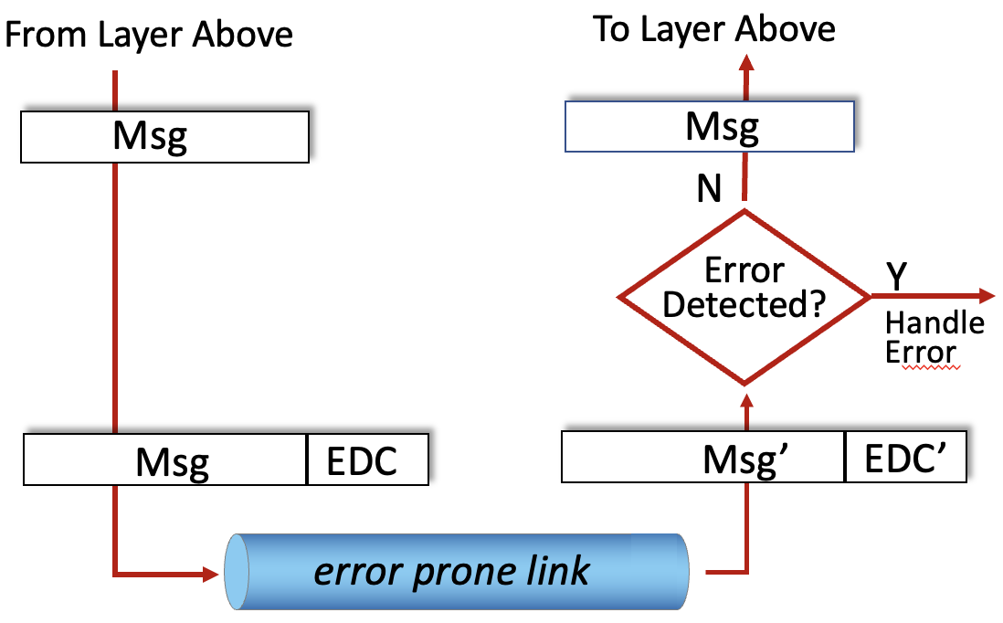
Error Detection and/or Correction
Error detection and/or correction bits (EDC) are often added at the Data Link, Network and Transport layers.
Ethernet uses the Cyclic Redundancy Code (CRC) for EDC.
We will look at some simpler techniques.
Image adapted from: http://gaia.cs.umass.edu/kurose_ross/videos/6/2/6.2_video_slides.pptx

Slide 23
Parity Bit
Which of the following even parity values contains a transmission error?
1001 0101 0
0111 0111 1
1011 1001 1
A parity bit is an extra bit appended to a piece of data (typically each byte) to detect errors in transmission.
Even Parity – the parity bit is chosen so that the data + parity bit has an even number of 1’s.
Odd Parity can also be used.
What odd parity bit would be added to the following bytes before transmission?
1001 0101 __
0111 0111 __
1011 1001 __

Slide 24


Acknowledgments
Slide Template From:
https://creativecommons.org/licenses/by/4.0/
Slide Content Licensed as:
Creative Commons Attribution-NonCommercial-ShareAlike 4.0 International License.
Notes:
Note: Individual images may be covered by their own licensing agreements and were incorporated here under fair use. Their use in this slide deck does not change or alter their licensing.

Slide 25
Some Physical Layer Encodings for Optical
Notes:
Maybe add in the future…

Slide 26
Internet Checksum

Slide 27
Switching vs. Broadcast

Slide 28
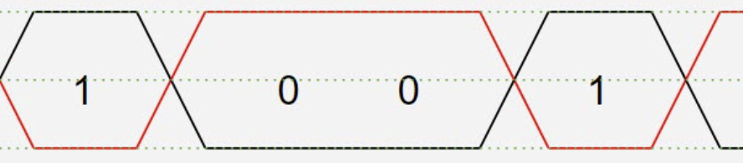
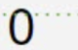
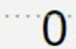
Physical Layer Transmission: Wired
Wired networks use different media, but one common one Twisted (differential) Pair.
+V_{ss}
Differential
Pair Media
-V_{ss}
Clock
Image adapted from: https://www.microcontrollertips.com/what-is-differential-signaling-faq/

Slide 29
Network Protocols

Slide 30
Network Protocols
Used for communication between source and destination within a layer
Application (HTTP, SMTP, …)
Transport (TCP/UDP)
network layer (IP)
link layer (ethernet)
Physical layer (encodings)

